Slide 1
User Interface
Иван Џиковски
Ведра Стојановска

Slide 2
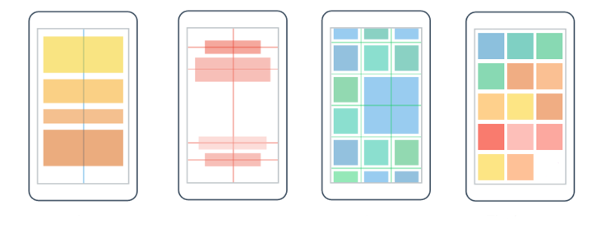
Layouts
StackLayout
AbsoluteLayout
Grid
FlexLayout

Slide 3
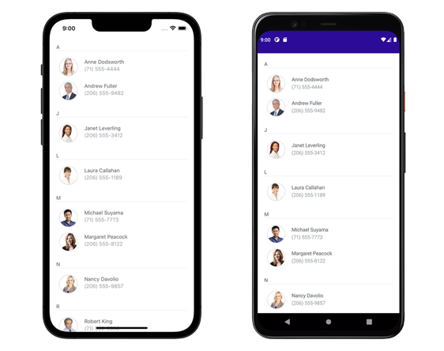
CollectionView

Slide 4
QUESTIONS?
You can find us at
ivan.dzikovski@gmail.com
vedrastojanovska@gmail.com
You can find the code at
Repository with the code Link

Slide 5
Discussion

